Slide 1
An introduction to docker recent events
Huichao Zhao

Slide 2
https://www.docker.com/survey-2016

Slide 3
Building management APIs around containers rather than machines shifts the "primary key" of the data center from machine to application. This has many benefits:
it relieves application developers and operations teams from worrying about specific details of machines and operating systems;
it provides the infrastructure team flexibility to roll out new hardware and upgrade operating systems with minimal impact on running applications and their developers;
it ties telemetry collected by the management system (e.g., metrics such as CPU and memory usage) to applications rather than machines, which dramatically improves application monitoring and introspection, especially when scale-up, machine failures, or maintenance cause application instances to move.

Slide 4
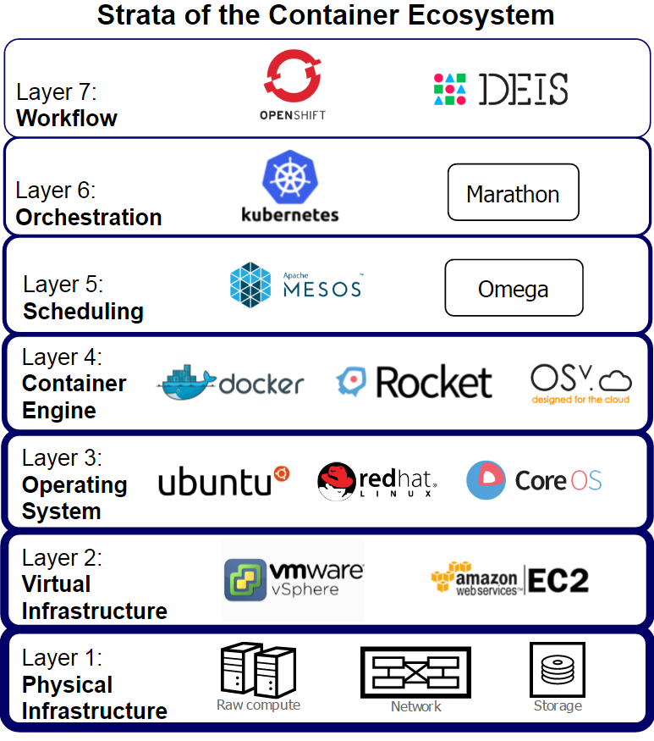
October 18, 2015
https://getcarina.com/docs/best-practices/container-technologies-orchestration-clusters/

Slide 5
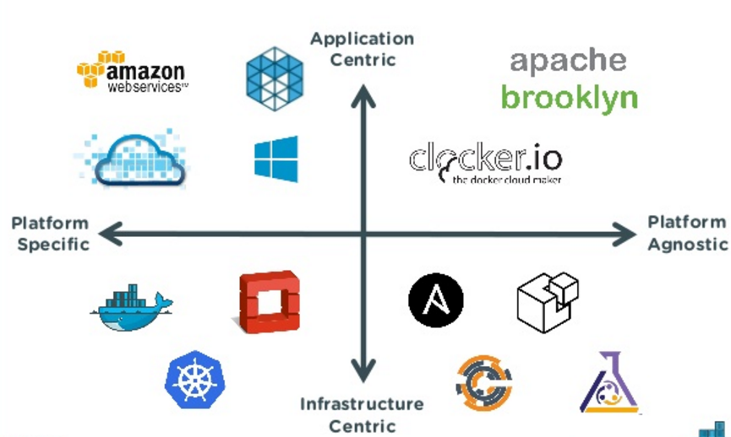
http://www.slideshare.net/Docker/multicontainer-apps-spanning-docker-mesos-and-openstack

Slide 6
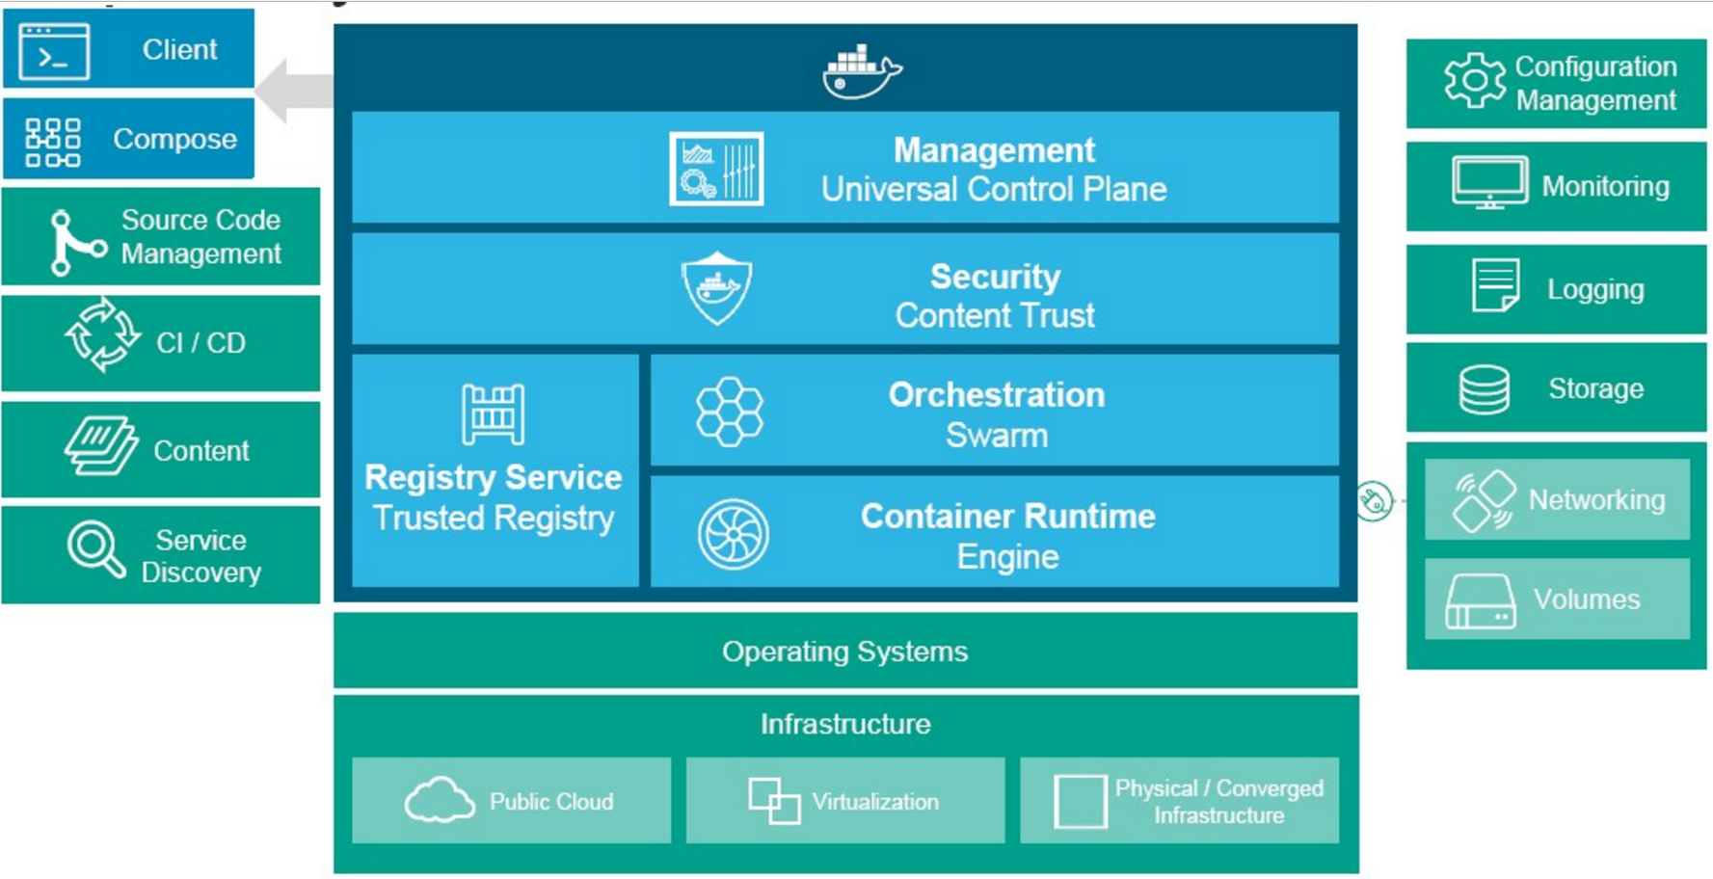
http://www.nextplatform.com/2016/02/23/docker-trickles-down-from-hyperscale-to-enterprise/

Slide 7
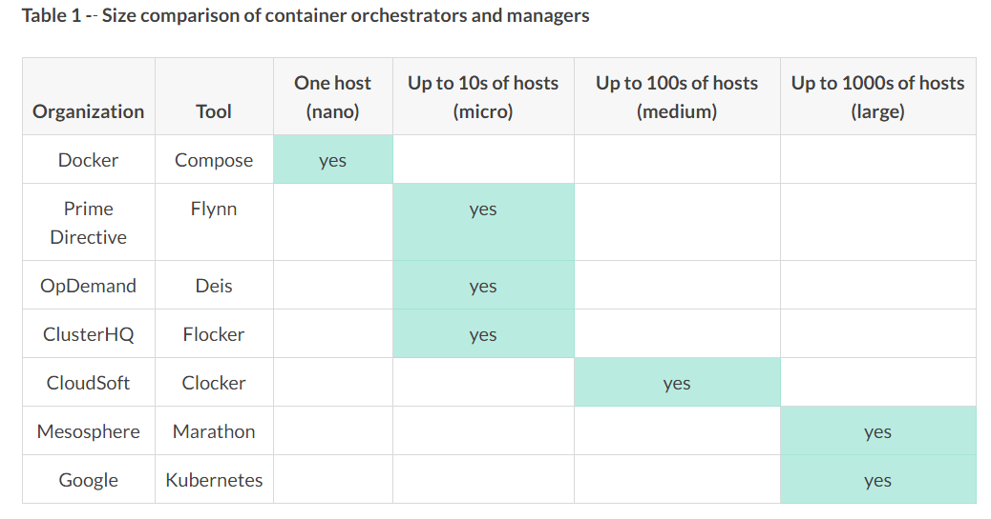
October 18, 2015
https://getcarina.com/docs/best-practices/container-technologies-orchestration-clusters/

Slide 8
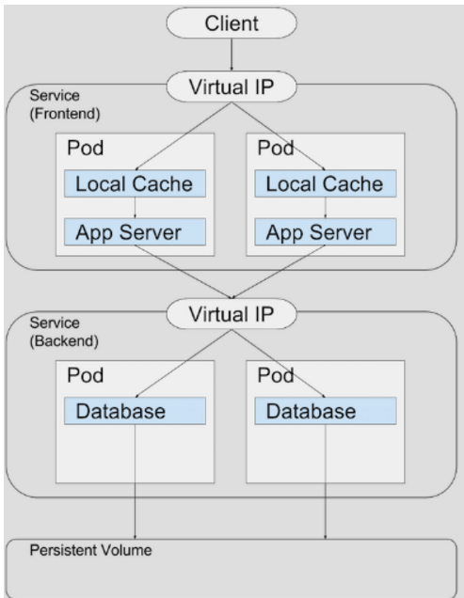
http://www.stratoscale.com/blog/kubernetes/container-orchestration-kubernetes-12-key-features/

Slide 9
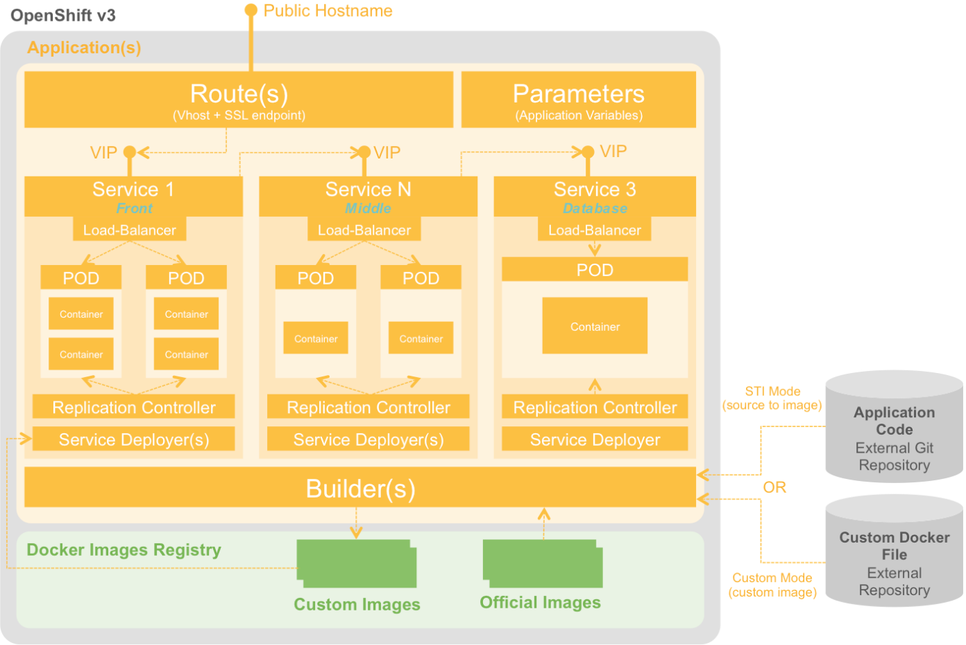
http://blog.octo.com/openshift-3-le-paas-prive-avec-docker/

Slide 10
1 – Managing multiple containers as one entity is a capability that logically groups a set of containers into one entity to co-locate main application with its helpers. This preserves the one-application-per-container model, or can define a complex multi-tier application as a set of smaller entities working together.
2 – Container placement is an algorithm that selects a specific host for a specific container or a set of containers using different rules, including current load of the hosts, colocation constraints and availability constraints.
3 – Container replication ensures that a specified number of equivalent containers (“replicas”) are running at the time.
4 – Container auto-scaling automatically change the number of running containers, based on CPU utilization or other application-provided metrics.
5 – Volume management is used to control persistent storage for containers. According to best practises, containers should be stateless and files in a container should be ephemeral . Kubernetes supports two kinds of volumes:
Regular: has the same lifecycle as the the pod that encloses it
Persistent: has a lifecycle independent of any individual pod
6 – Resource usage monitoring (CPU and RAM) is required at different levels – at the container level, at the logical group level (for example, Kubernetes Pods) and at the cluster level.
Kubernetes includes cAdvisor, an open source container resource usage and performance analysis agent.
http://www.stratoscale.com/blog/kubernetes/container-orchestration-kubernetes-12-key-features/

Slide 11
7 – Networking plays a significant role for container orchestration to isolate independent containers, connect coupled containers and provide access to containers from external clients.
Kubernetes has a pluggable architecture and allows to use different overlay network implementationsincluding simple one L2 networking with Linux bridges, overlay network using OpenVSwitch, Flannel, Calico and so on.
8 – Service discovery allow containers to discover other containers and establish connections to them.
Kubernetes supports 2 primary modes of finding a service via environment variables and via DNS. Per service, Kubernetes create environment variables such as {SERVICE_NAME}_SERVICE_HOST and {SERVICE_NAME}_SERVICE_PORT. For the same service a DNS record for “service.ns” is created,
9 – Load balancing works in conjunction with container replication, scaling and service discovery. Connections to the exposed endpoint are distributed over running replicas using different methods such as DNS round-robin.
10 – Rolling update allows you to update a deployed containerized application with minimal downtime using different update scenarios. Rolling update ensures that only a certain number of old replicas may be down while they are being updated and ensures only a certain number of new replicas may be created above the specified number.
11 – Kubernetes allows using rolling updates for replication controllers and deployments. A Kubernetes Deployment defines a desired state for logical group of pods or replica sets. A Deployment Controller drives the actual state to the desired state at a controlled rate, it creates new resources or replaces the existing resources, if necessary. Deployments can be updated, rolled out, or rolled back.
http://www.stratoscale.com/blog/kubernetes/container-orchestration-kubernetes-12-key-features/

Slide 12
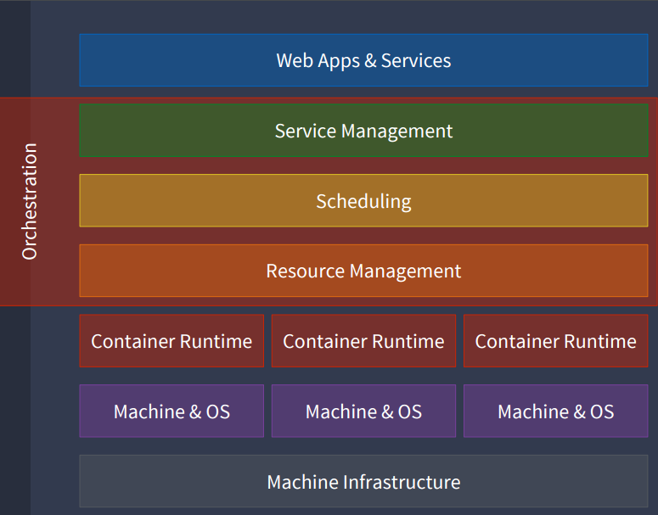
CONTAINER ORCHESTRATION
FUNCTIONAL CAPABILITIES

Slide 13
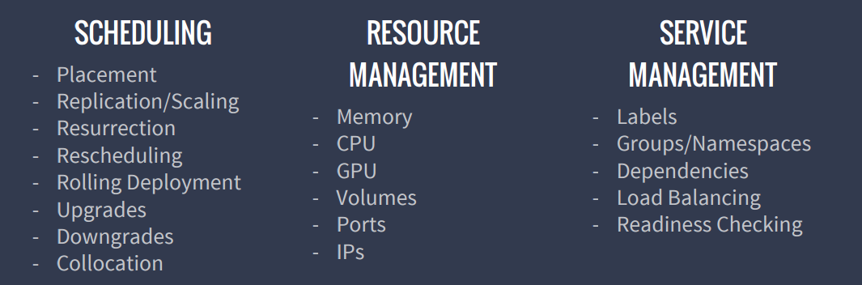
CONTAINER ORCHESTRATION
FUNCTIONAL CAPABILITIES

Slide 14
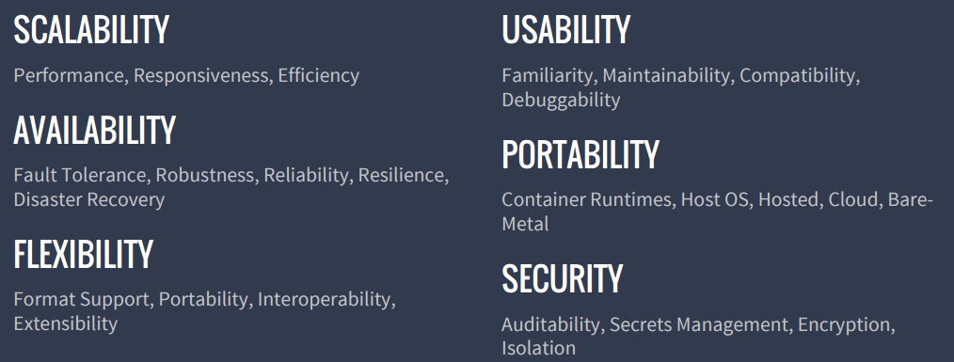
CONTAINER ORCHESTRATION
NON-FUNCTIONAL QUALITIES

Slide 15
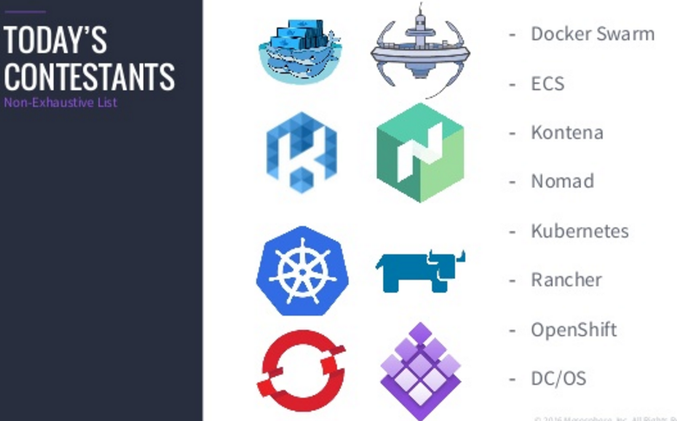
http://www.slideshare.net/KarlIsenberg/container-orchestration-wars?qid=76616e6f-927a-4978-97d9-aea38db366e2&v=&b=&from_search=2

Slide 16
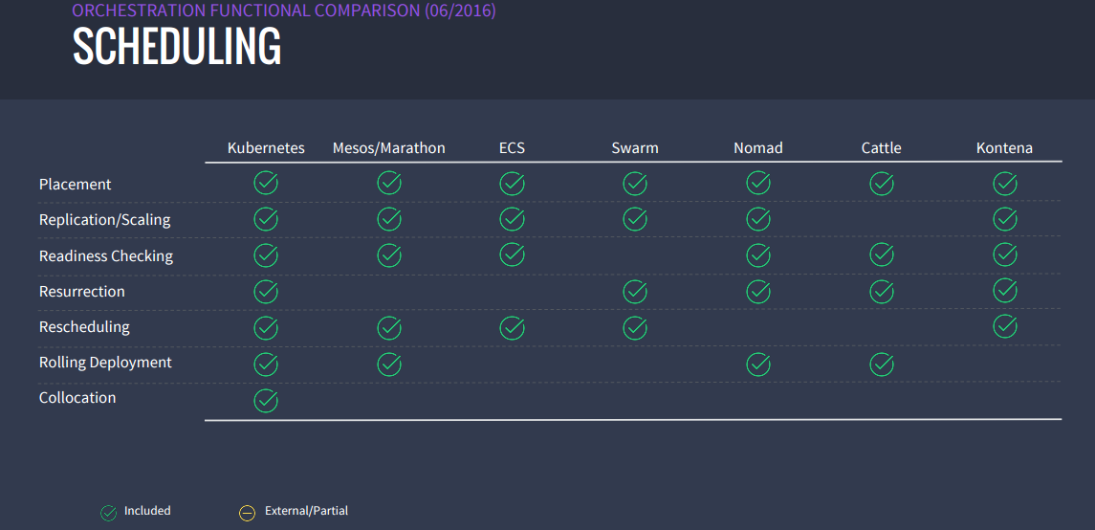

Slide 17
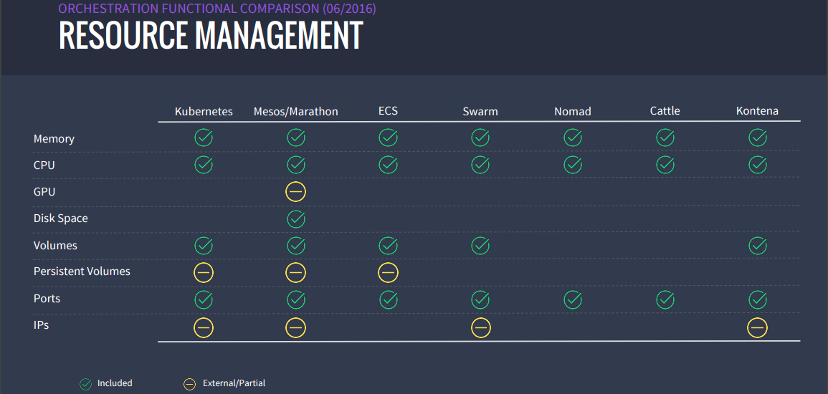

Slide 18
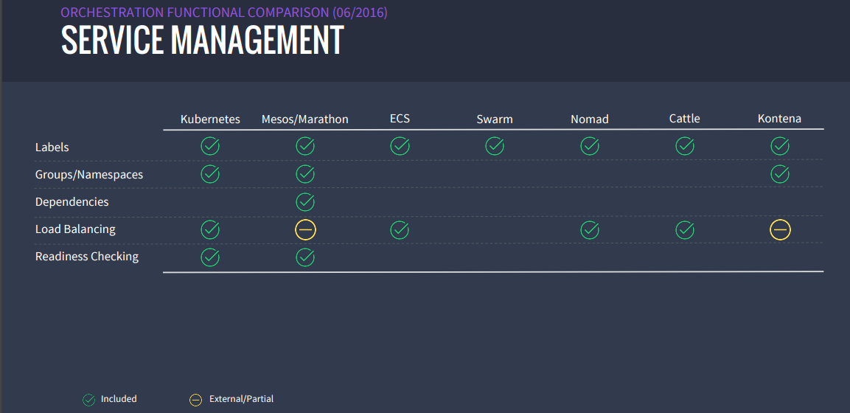

Slide 19
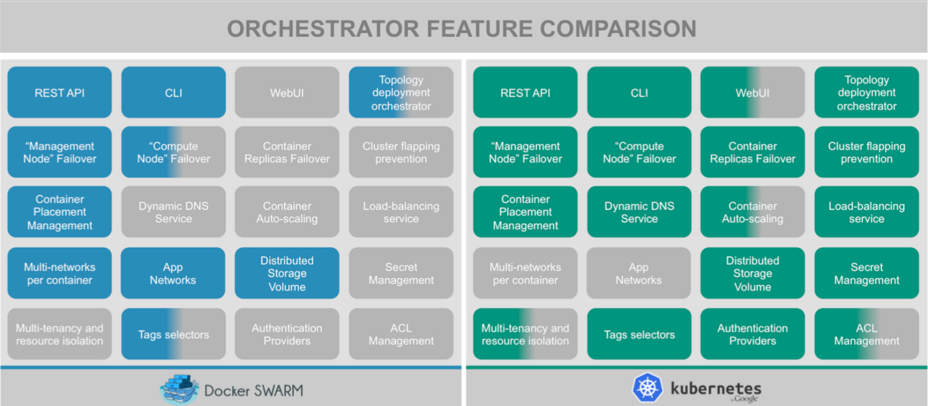
http://blog.octo.com/docker-en-production-la-bataille-sanglante-des-orchestrateurs-de-conteneurs/

Slide 20
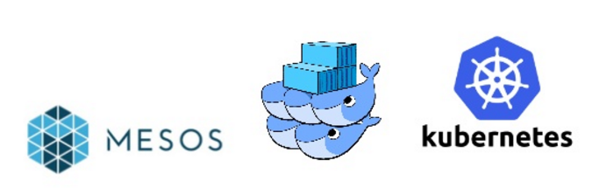
Kubernetes is a full-bore container management platform with scheduling, upgrades on-the-fly, auto-scaling and constant health monitoring. Google we have been managing Linux containers at scale for more than ten years and built three different container-management systems in that time. Borg, Omega, and Kubernetes: Lessons learned from three container-management systems over a decade
In comparison, Docker Swarm concentrates on providing a system-wide view of a cluster from a single Docker engine. Swarm can scale up to 50,000 containers and 1,000 nodes with no effect on performance as new containers are added to the cluster. Swarm is a simple system at its heart: every host runs a Swarm agent and manager. The manager handles the operation and scheduling of containers. You can run it in high-availability situations – it uses Consul, ZooKeeper or etcd to send fail-over events to a backup system.
One of the advantages of Docker Swarm is that it is a native solution – you can implement Docker networking, plugins and volumes using Docker commands.
Mesos does not concentrate as much as Kubernetes on running clusters, focusing instead on features like its strong scheduling capabilities and its ability to be plugged in a wide variety of schedulers.
https://blog.appdynamics.com/devops/4-cluster-management-tools-to-compare/

Slide 21
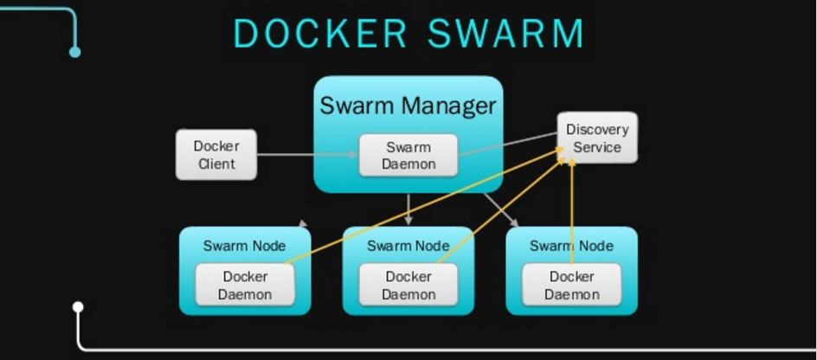
Adrian Otto，Aug 2016
http://www.slideshare.net/adrianjotto/openstack-magnum-20160804?qid=f03a813a-a899-4daf-9d78-ec208650997f&v=&b=&from_search=3

Slide 22
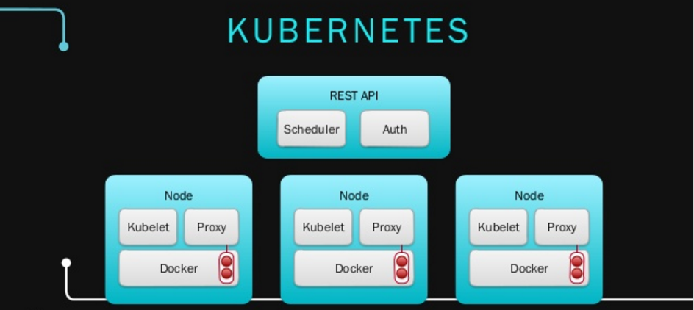
Adrian Otto，Aug 2016
http://www.slideshare.net/adrianjotto/openstack-magnum-20160804?qid=f03a813a-a899-4daf-9d78-ec208650997f&v=&b=&from_search=3

Slide 23
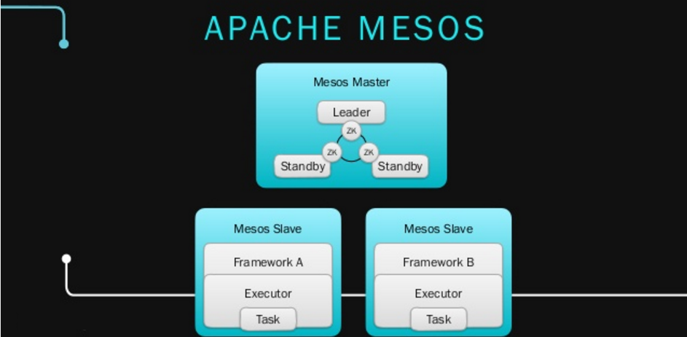
Adrian Otto，Aug 2016
http://www.slideshare.net/adrianjotto/openstack-magnum-20160804?qid=f03a813a-a899-4daf-9d78-ec208650997f&v=&b=&from_search=3

Slide 24
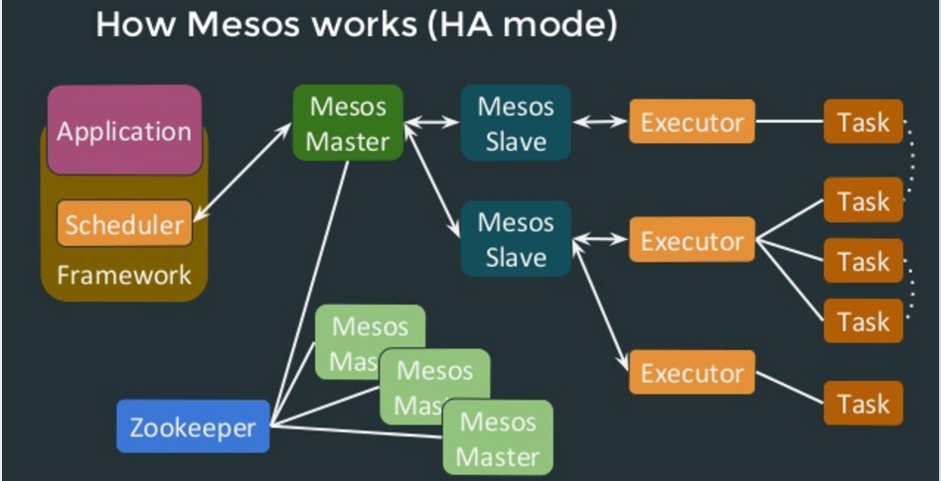

Slide 25
http://datacenteroperatingsystem.io/

Slide 26
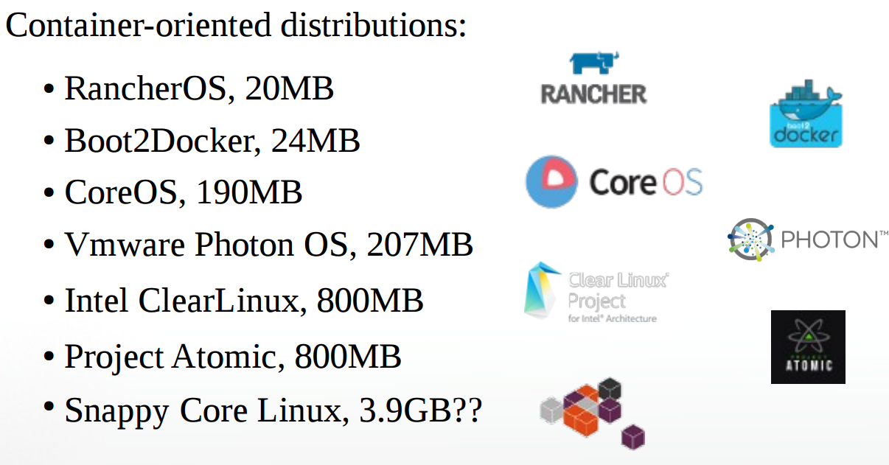
Host OS Options
Dermot Bradley, Sep 2015
http://www.slideshare.net/DermotBradley/microcontainers-microservices-microservers-less-linux-is-more

Slide 27
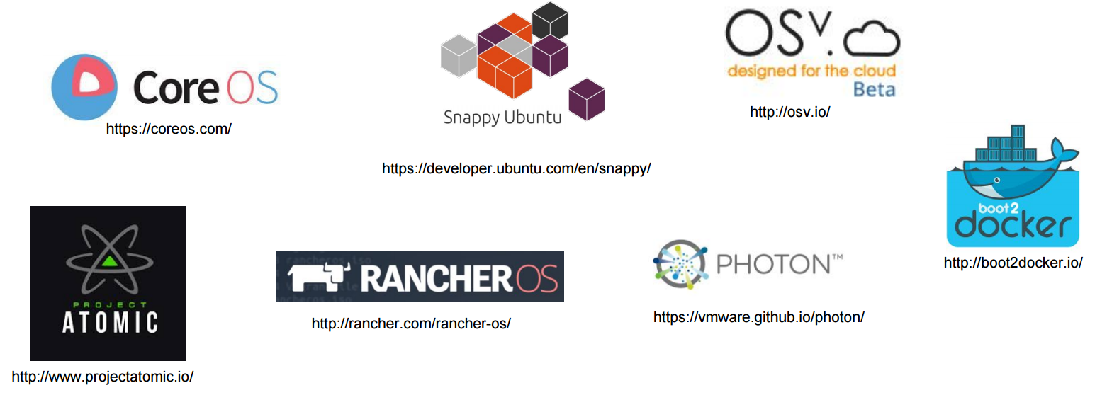
A tiny Linux distribution created for container
GEPOSTET AM 4. MAI 2015
https://www.inovex.de/blog/docker-a-comparison-of-minimalistic-operating-systems/

Slide 28
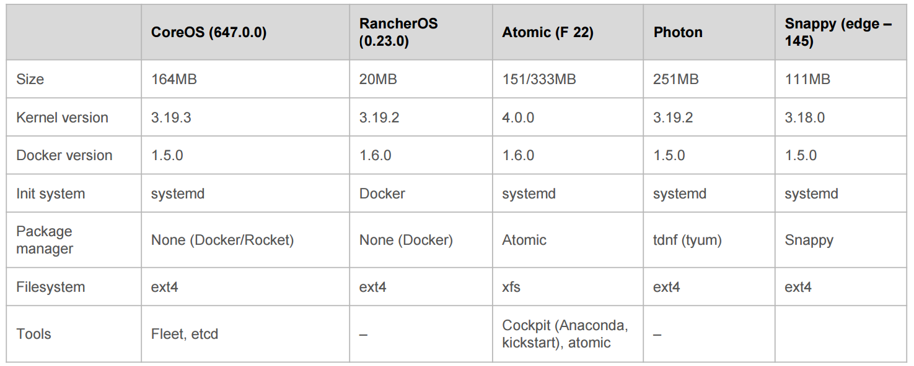
A tiny Linux distribution created for container
GEPOSTET AM 4. MAI 2015
https://www.inovex.de/blog/docker-a-comparison-of-minimalistic-operating-systems/

Slide 29
A common set of ideas:
● Stability is enhanced through transactional upgrade/rollback semantics.
● Traditional package managers are absent and may be replaced by new packaging systems (Snappy), or custom image builds (Atomic).
● Security is enhanced through various isolation mechanisms.
● systemd provides system/service management. In general, systemd has been adopted almost universally among Linux distributions, so this shouldn’t be a surprise.
http://www.slideshare.net/ejlp12/linux-containarization-docker

Slide 30
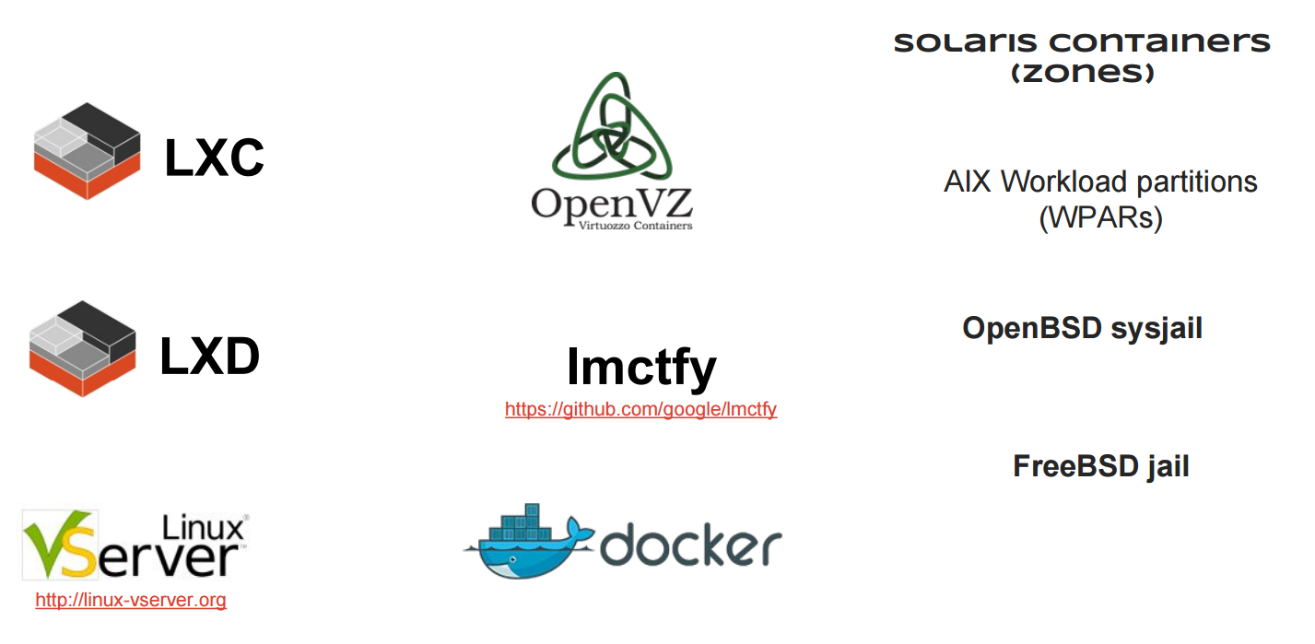
OS-Level Virtualization
http://www.slideshare.net/ejlp12/linux-containarization-docker

Slide 31
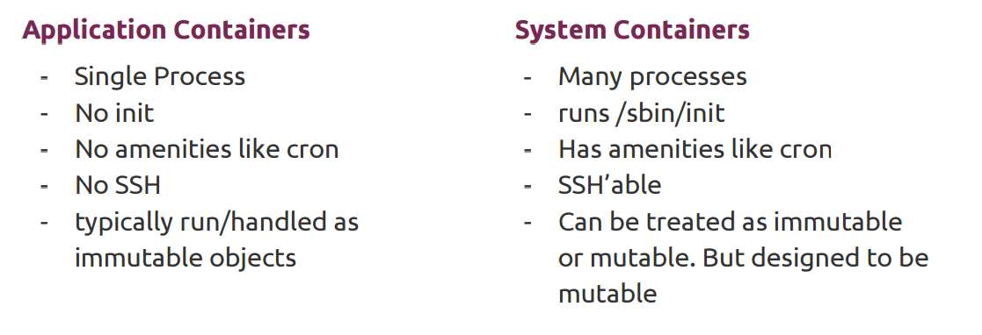
OS-Level Virtualization
https://archive.fosdem.org/2016/schedule/event/config_management_containers/attachments/slides/1110/export/events/attachments/config_management_containers/slides/1110/lazypower_fosdem2016_configmanagement_and_containers.pdf

Slide 32
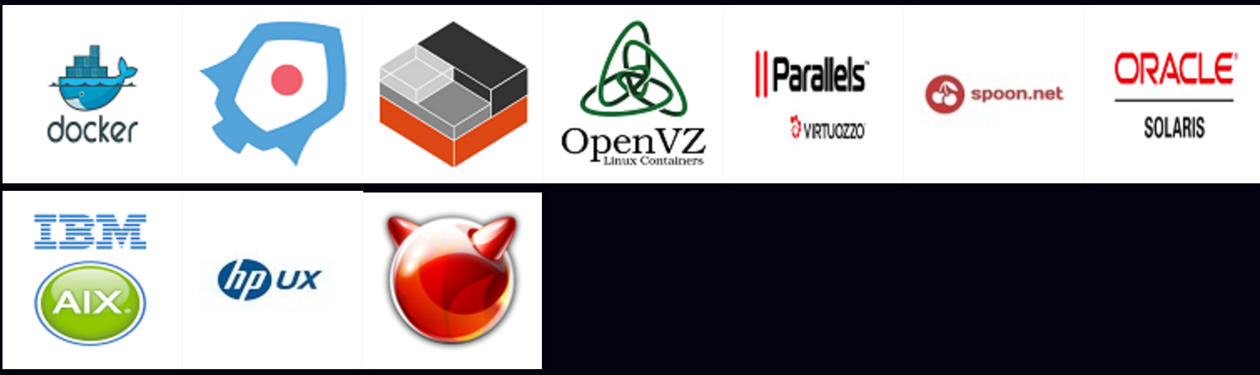
1. Full System Containers
Full system containers or OS containers share the kernel of host operating system but provide user space isolation.
User space is nothing but allowing host CPU to partition memory allocation into isolation levels.
Example: LXC/LXD, OpenVZ, Oracle Solaris Zones, FreeBSD Jails
2. Application Containers
Application containers also share the host operating system kernel just like OS containers.
These containers are designed to run a single process (process tree) or application.
Here containers provide a limited control over services and configuration files due to which admin users who require to perform admin related activities to guarantee SLAs, cannot perform tasks like logging, ssh, cron, networking activities like setting up static IP, modifying system files like /etc/hosts and monitoring system using system tools and utilities is bit complicated task to perform and a nightmare to actually manage.
Example: Docker, rkt
https://hashprompt.blogspot.com/

Slide 33
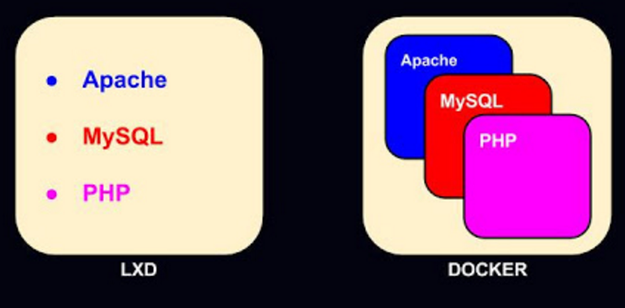
Difference Between LXD and Docker
LXD is a OS container or system container whereas docker is a application container.
Principal process for LXD is liblxc whereas docker has recently started using it's own libcontainer. Earlier docker also used to have liblxc as the principal process.
LXD wraps up application inside a "userspace image" as opposed to docker that holds the application in a self contained filesystem which makes it ephemeral and stateless.
LXD runs init process which a parent to all processes and services, whereas docker runs a single process per application in the container.
LXD specializes in deploying virtual machines whereas Docker specializes in deploying applications.
Administrator related activities can be easily managed in LXD, but for docker it can be complicated to configure, tune and monitor the system.
LXD works just like any other hypervisor with shared kernel. Whereas in docker, only the outer layer is writable and all other internal layers are read-only. It can be best compared to an onion.

Slide 34
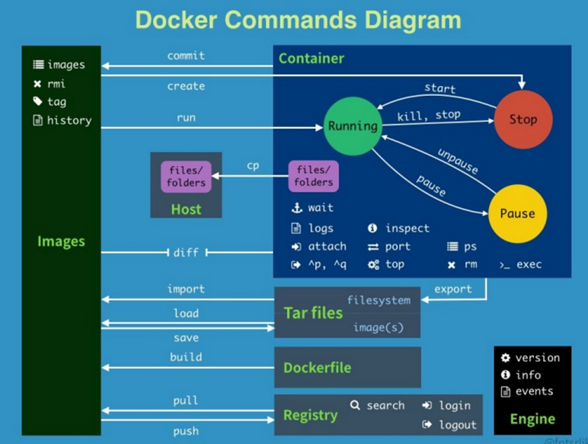
http://www.slideshare.net/zx1986/docker-66986880?qid=1d1461b5-ac95-4303-b06f-10afb72ae4b3&v=&b=&from_search=12

Slide 35
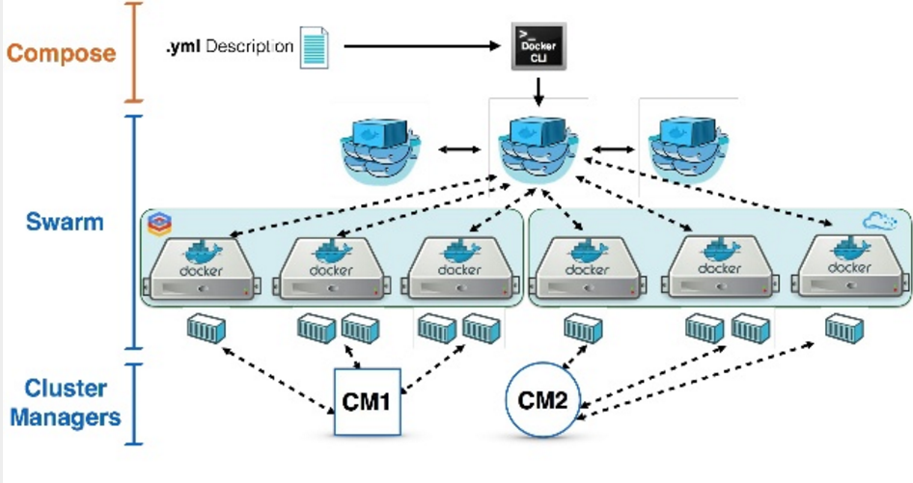
http://www.slideshare.net/dustinkirkland/streamlining-hpc-workloads-with-containers?qid=bad52f10-d5e7-4741-bc13-b80935c288af&v=&b=&from_search=2

Slide 36
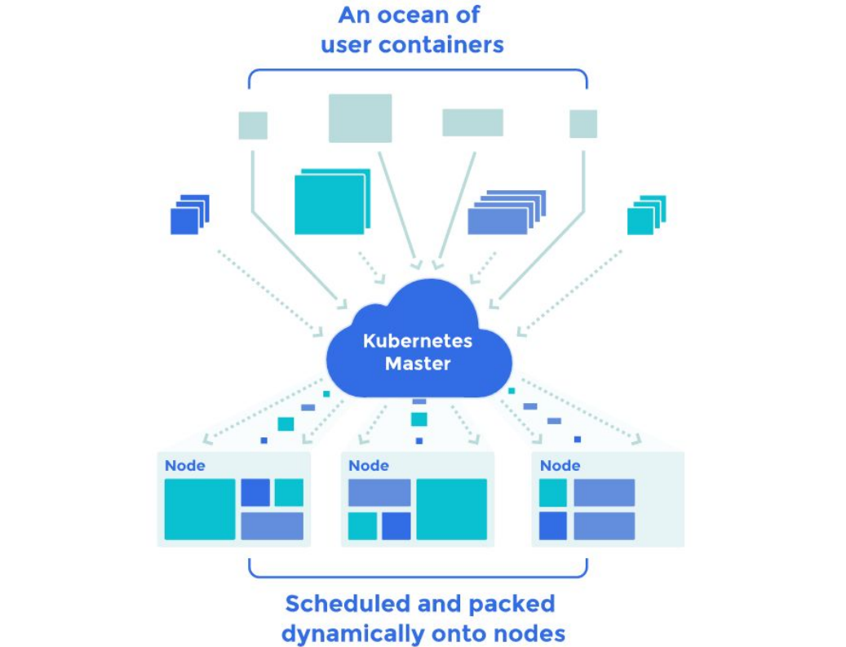
http://www.slideshare.net/dustinkirkland/streamlining-hpc-workloads-with-containers?qid=bad52f10-d5e7-4741-bc13-b80935c288af&v=&b=&from_search=2

Slide 37
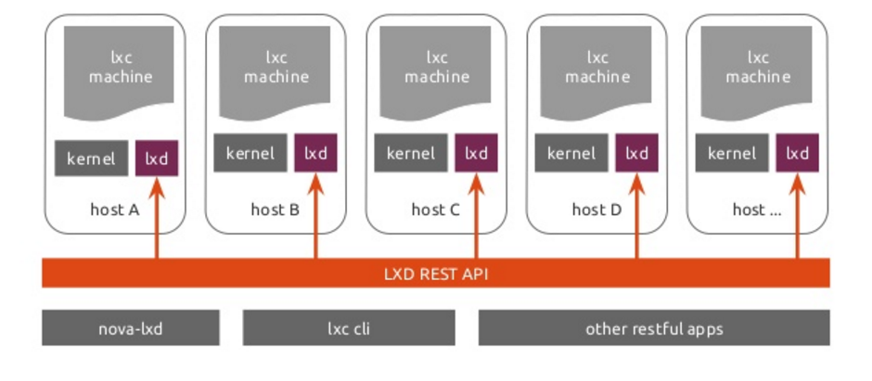
One LXD container, with 100% of the system:
CPU Cores, CPU Cycles, Memory, Disk Space, Disk IO, Network IO
zero latency, zero overhead, identical performance, snapshot restore, live migration
http://www.slideshare.net/dustinkirkland/streamlining-hpc-workloads-with-containers?qid=bad52f10-d5e7-4741-bc13-b80935c288af&v=&b=&from_search=2

Slide 38
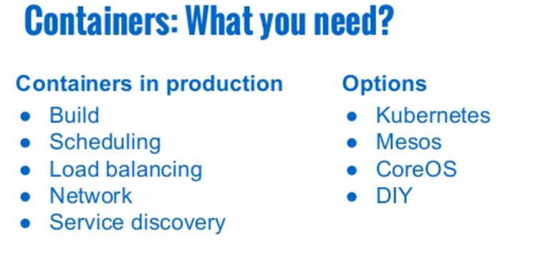
http://www.slideshare.net/Cloud-A/simplify-the-cloud-with-clouda-annd-cloud-66-webinar-deck

Slide 39
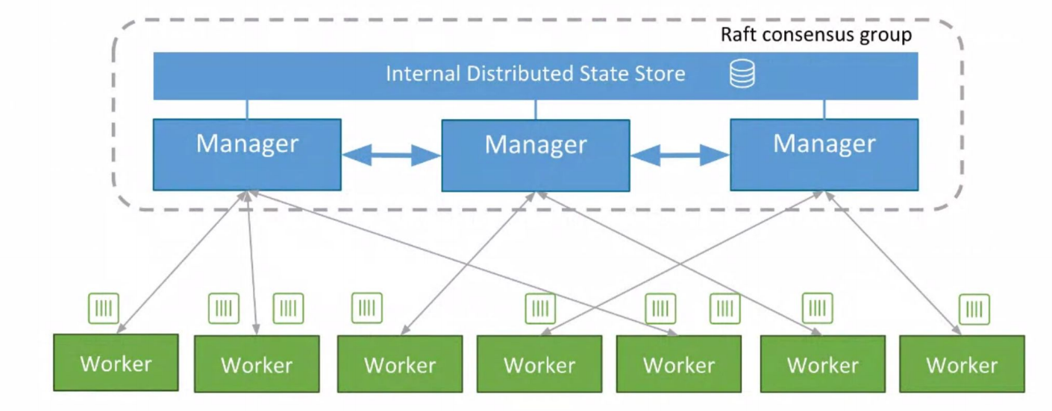
Swarm Architecture
http://www.slideshare.net/PhilippGarbe1/dockercon-2016-seattle-recap?qid=30f21fe6-66ea-4a1d-9234-7da4a9482048&v=&b=&from_search=2

